Slide 1
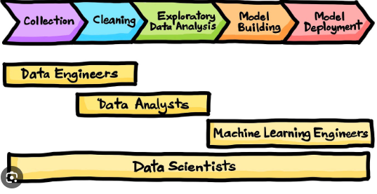
To address the problem statement of accurately predicting stock levels of products based on sales data and sensor data on an hourly basis, we'll need to make strategic decisions on how to use the available data and create a plan to achieve this goal.
Data Selection: Based on the provided data model diagram, we have three relevant tables:
sales: This table contains sales data. We can use this data to understand the historical sales patterns of different products and identify any seasonality or trends.
sensor_storage_temperature: This table provides IoT data from temperature sensors in the storage facility. It can help us monitor the temperature conditions in the warehouse, which might affect the shelf life of certain products.
sensor_stock_levels: This table contains estimated stock levels of products based on IoT sensors. This data is directly related to the problem statement, and it's crucial for building predictive models.
Collection
Cleaning
Exploratory Data Analysis
Model Building
Model Deployment
Data collection is the process of gathering information from various sources, such as surveys, sensors, or databases, to acquire a comprehensive dataset
Data cleaning is the meticulous process of identifying and rectifying errors, inconsistencies, and inaccuracies within a dataset, ensuring its integrity and reliability for analysis.
Exploratory Data Analysis (EDA) involves utilizing statistical and visual techniques to examine and summarize key characteristics, patterns, and relationships within a dataset.
Model building in data science is the process of creating mathematical representations or algorithms that capture patterns and relationships within a dataset
Model deployment is the final phase in the data science lifecycle, involving the integration of a trained model into a production environment where it can generate real-time predictions or support decision-making

